Slide 1
Moona
Company Profile
Here is where your
presentation begins

Slide 2
Contents of this template
Here’s what you’ll find in this Slidesgo template:
A slide structure based on a company profile presentation, which you can easily adapt to your needs. For more info on how to edit the template, please visit Slidesgo School or read our FAQs.
An assortment of pictures and illustrations that are suitable for use in the presentation can be found in the two alternative resources slides.
A thanks slide, which you must keep so that proper credits for our design are given.
A resources slide, where you’ll find links to all the elements used in the template.
Instructions for use.
Final slides with:
The fonts and colors used in the template.
A selection of illustrations. You can also customize and animate them as you wish with the online editor. Visit Stories by Freepik to find more.
More infographic resources, whose size and color can be edited.
Sets of customizable icons of the following themes: general, business, avatar, creative process, education, help & support, medical, nature, performing arts, SEO & marketing, and teamwork.
You can delete this slide when you’re done editing the presentation.

Slide 3
01
02
03
Table of contents
About our company
Here you could describe the topic of the section
Our services/products
Here you could describe the topic of the section
Our clients
Here you could describe the topic of the section

Slide 4
01
About our company

Slide 5
About us
Mercury is the closest planet to the Sun and the smallest one in the Solar System—it’s only a bit larger than the Moon. The planet’s name has nothing to do with the liquid metal

Slide 6
2010
2013
2016
Our history
Mars
Mercury
Venus
Despite being red, Mars is actually a cold place
Mercury is the closest planet to the Sun
Venus has a beautiful name. It’s terribly hot

Slide 7
Our philosophy
Mission
Vision
Values
Despite being red, Mars is actually a cold place. It’s full of iron oxide dust
Jupiter is a gas giant and the biggest planet in the Solar System
Mercury is the closest planet to the Sun and the smallest one

Slide 8
—Someone Famous
“This is a quote, words full of wisdom that someone important said and can make the reader get inspired.”

Slide 9
Bulleted list
Mercury is the closest planet to the Sun
Venus has a beautiful name, but it’s terribly hot
Despite being red, Mars is a cold place
It’s the biggest planet in our Solar System
Saturn is the ringed one and a gas giant
Neptune is the farthest planet from the Sun

Slide 10
Parts of the company
Neptune | Neptune is the farthest planet from the Sun. It’s the fourth-largest by diameter and the densest
Jupiter | Jupiter is the biggest planet in the Solar System and the fourth-brightest object in the sky
Mars | Mars is actually a cold place. It’s full of iron oxide dust which gives the planet its reddish cast

Slide 11
Customer profile
Gender
Age
Female
Male
60%
40%
25%
55%
15%
Interest
Design
Photo
Music
05-20 years old
21-40 years old
41-60 years old

Slide 12
Locations
Despite being red, Mars is a cold place. It’s full of iron oxide dust

Slide 13
Our services
Mercury
Venus
Mars
Mercury is the smallest planet
Venus is a terribly hot place
Mars is a really cold place
Saturn
Neptune
Earth
It’s a gas giant and has rings
It’s the farthest one from the Sun
This is where we live on

Slide 14
Best sellers
Mercury
Venus
Mars
Mercury is the closest planet to the Sun
Venus has a beautiful name, but it’s terribly hot
Despite being red, Mars is actually a cold place

Slide 15
Our strengths
Loyalty
Efficiency
Neptune is the farthest planet from the Sun and the fourth-largest of them all
Jupiter is the biggest planet in the Solar System and the fourth-brightest object in the sky
Reliability
Commitment
Mercury is the closest planet to the Sun and also the smallest one in the Solar System
Despite being red, Mars is a cold place. It’s full of iron oxide dust, which makes it red

Slide 16
3,200
Employees

Slide 17
Awesome words
Because key words are great for
catching your audience’s attention

Slide 18
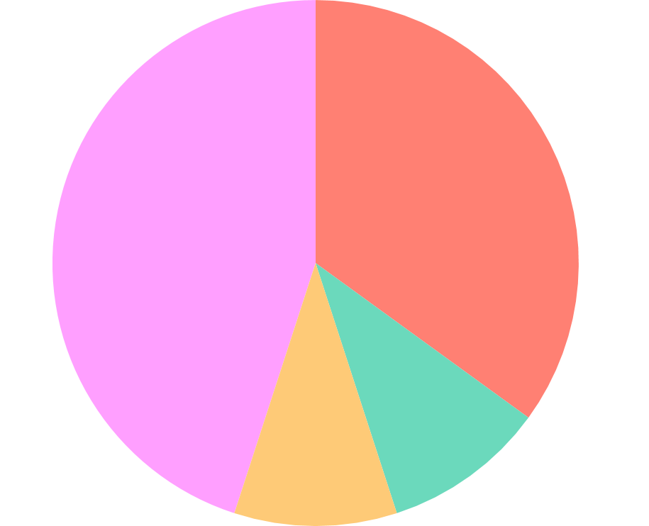
Our numbers
35%
10%
10%
45%
People
Market
Retail
Sales
To modify this graph, click on it, follow the link, change the data and paste the new graph here

Slide 19
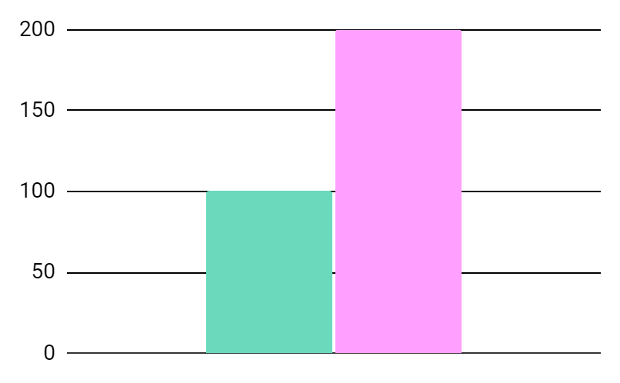
Our growth
200%
Despite being red, Mars is actually a cold place
100%
Saturn is composed of hydrogen and helium
To modify this graph, click on it, follow the link, change the data and paste the new graph here

Slide 20

A picture is worth a thousand words

Slide 21
Future projects
1
2
3
4
Venus
Mars
Jupiter
Neptune
Venus has a beautiful name, but it’s hot
Despite being red, Mars is actually a cold place
It’s the biggest planet in the entire Solar System
Neptune is the farthest planet from the Sun

Slide 22
Customer testimonials
“Neptune is the farthest planet from the Sun and the fourth-largest”
“Despite being red, Mars is actually a cold place. It’s full of iron oxide dust”
—Helena James
—Jenna Doe

Slide 23
This sentence is important

Slide 24


Venus has a beautiful name, but it’s hot
Neptune is the farthest planet from the Sun

Slide 25
Awards
Venus
Mars
Jupiter
Venus has a beautiful name, but it’s very hot
Despite being red, Mars is actually a very cold place
It’s the biggest planet in the Solar System

Slide 26



Our team
John James
Jenna Doe
Jane Patterson
Venus has a beautiful name
Despite being red, Mars is cold
It’s the biggest planet of them all

Slide 27
Sneak peek
You can replace the image on the screen with your own work. Just delete this one, add yours and center it properly

Slide 28
Thanks!
Does anyone have any questions?
addyouremail@freepik.com
+91 620 421 838
yourcompany.com
Please keep this slide for attribution

Slide 29
Alternative Resources

Slide 30
Alternative Resources
Studio shot of pretty black woman with white shopping bag standing
Excited african woman holding shopping bags and mobile phone
Woman with book thinking
Geometric shapes and memphis background
Memphis pattern collection background

Slide 31
Resources
Did you like the resources on this template? Get them for free at our other websites.
Vectors
Colorful memphis pattern collage
Seamless memphis pattern set
Photos
Medium shot guy thinking
Smiling beautiful young woman in pink mini dress posing
Young pretty woman wearing in hat and sunglasses
Portrait of schoolgirl studying with laptop

